Slide 1
Font
A font is basically a graphical representation of a character or a group of characters that includes different type faces, sizes, weights, slopes, colours, or designs.
The different CSS font properties are-
font-family
font-size
font-style
font-variant
font-weight
font

Slide 2
font-family
We can specify a list of font names for the text contained inside an HTML element, using font-family property.
Ex:-
p { font-family: Arial, serif, "Times New Roman"; }
If the name of a font family is more than one word, it must be in quotation marks.
Ex:-
“Times New Roman”
Times
Note: The font-family property in CSS can take values as a prioritized list, i.e., It can hold various font names as a "fallback" system. The first mentioned font will have the highest priority, and if the browser doesn't support the first one, it will jump to the next mentioned font. These fonts should be separated by commas.

Slide 3
Step 1: Include the Font from Google Fonts
Go to Google Fonts.
Search for the font you want to use. For this example, we will use Roboto.
Click on the font you like and select the weights/styles you want (e.g., Regular 400, Bold 700).
Copy the provided <link> tag.
Which <link> tag to select:
Essential:
You must include the third <link> tag (the one with the href="https://fonts.googleapis.com/css2... URL) in your <head> section of the HTML to load the Google Font.
Optional but Recommended:
You can also include the first and second <link> tags to preconnect to the Google Fonts server, which can improve the performance of loading the font, but these are not required for the font to work.

Slide 4
font-size
We can specify a font size for the text. We can specify size in the form of percentage, px, em.
Ex:-
p { font-size: 50%; }
p { font-size: 16px }
p { font-size: 2em; }
p { font-size: xx-small; }
The default text size in browsers is 16px or 1em.
Font-size: 20%;
In the above example, If the size of the parent element is 100px, then the size of the child will be 20px.
xx-small
x-small
small
medium
large
x-large
xx-large
smaller
larger

Slide 5
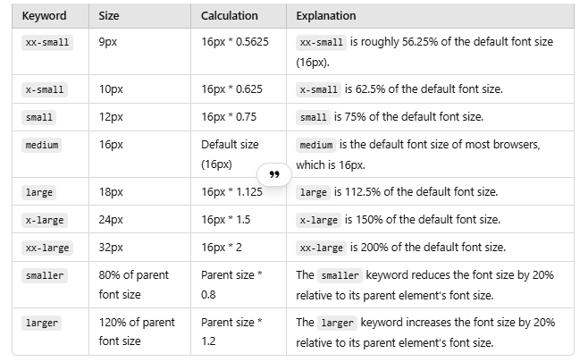

Slide 6
font-style
CSS font-style property is used to define the style of font for the text content of an element. Here, style refers to the variation in the typeface. It may be italic, oblique(Similar to italic), inherit or normal(default).
Font-style property can be used to decorate and assign importance to a specific text.
Ex:-
p { font-style: italic; }

Slide 7
font-variant
It specifies whether or not a font is a small-caps font. We can set this property to either normal or small-caps(capital letters that will be small in size as compared to normal capital letters).
Ex: -
p { font-variant: small-caps; }

Slide 8
font-weight
The font weight property allows to set the font weight of the text present on an HTML Page. We can set this property to normal, bold, bolder, lighter, number (100, 200, 300 upto 900)
Ex: -
p { font-weight: bold; }
p { font-weight: 500; }
Note: 400 has the same weight as normal, and 700 have the same as bold.

Slide 9
font
It defines a shorthand property for font-style, font-variant, font-weight, font-size, line-height, and font-family properties.
Ex:-
p { font: bold 20px serif;}
The properties must be set in order: "font-style font-variant font-weight font-size/line-height font-family"
The font-size and font-family values are required.

Slide 10
There are several ways to add icons to a webpage using CSS
Using Font Awesome Icons
<!-- Add Font Awesome CDN link -->
<link rel="stylesheet" href="https://cdnjs.cloudflare.com/ajax/libs/font-awesome/6.0.0-beta3/css/all.min.css">
<!-- Use Font Awesome icon -->
<i class="fas fa-home"></i> <!-- This is a home icon -->
2. Using Google Material Icons
<!-- Add Google Material Icons CDN link -->
<link href="https://fonts.googleapis.com/icon?family=Material+Icons" rel="stylesheet">
<!-- Use Material icon -->
<i class="material-icons">home</i> <!-- This is a home icon -->
3. Using SVG Icons
<img src="icon.svg" alt="Icon">

